Slide 1

Chapter 11
Testing Metrics for Monitoring and
Controlling the Testing Process
Objectives
Testing metrics are important to monitor and control all testing activities.
Attributes for software testing on the basis of which testing metrics are designed:
Progress metrics
Quality metrics
Cost metrics
Size metrics
Testing Effort estimation models
© Oxford University Press 2011. All rights reserved.

Slide 2
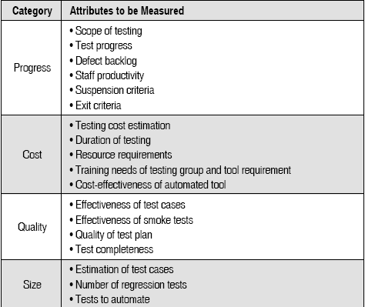
Evolution of Software Testing
Attributes and Corresponding Metrics
in Software Testing
© Oxford University Press 2011. All rights reserved.

Slide 3
Evolution of Software Testing
Effectiveness of Test Cases
Number of faults found in testing.
Number of failures observed by the customer which can be used as a reflection of the effectiveness of the test cases.
Defect removal efficiency
Defect age
Defect age is used in another metric called defect spoilage to measure the effectiveness of defect removal activities.
Spoilage = Sum of (Number of Defects x defect age) / Total number of defects
© Oxford University Press 2011. All rights reserved.

Slide 4
Estimation models for estimating testing efforts
Halstead metrics for estimating testing effort
PL = 1/ [(n1 / 2) * (N2 / n2)]
e = V/PL
Percentage of testing effort (k) = e(k) / ∑e(i)
V is program volume
PL iis Program level
e(k)=effort for module k
∑e(i)=effort across all module of the system
© Oxford University Press 2011. All rights reserved.

Slide 5
Project staff ratio method:
Calculating the percentage of testing personnel from the overall allocate resources planned for the project
© Oxford University Press 2011. All rights reserved.

Slide 6

Estimation models for estimating testing efforts
Project staff ratio method
© Oxford University Press 2011. All rights reserved.

Slide 7
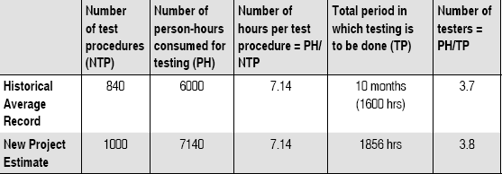
Test procedure method
The no. of test procedures decides the number of tester required and testing time.
© Oxford University Press 2011. All rights reserved.

Slide 8

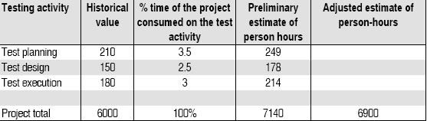

Estimation models for estimating testing efforts
Task planning method
Calculating number of person hours
Task planning method
Team size using task planning method
© Oxford University Press 2011. All rights reserved.

Slide 9
Architectural Design Metric used for Testing
Structural Complexity
S(m) = f2out(m)
where S is the structural complexity of a module m
and fout(m) is the fan-out of module m.
Data Complexity
D(m) = v(m) / [fout(m) + 1]
where v(m) is the number of input and output variables that are passed to and from module m.
System Complexity
SC(m) = S(m) + D(m)
© Oxford University Press 2011. All rights reserved.

Slide 10
Information Flow Metrics used for Testing
Local Direct Flow:
(i) module invokes a second module and passes information to it
(ii) the invoked module returns a result to the caller
Local InDirect Flow: exists if the invoked module returns information that is subsequently passed to a second invoked module.
Global Flow :flow from one module to another module via a global data structure.
© Oxford University Press 2011. All rights reserved.

Slide 11
Fan-in of a module :
No. of local flows that terminates at m,
Plus the no. of data structures from which information is retreived by m
Fan-out of a module :
No. of local flows that emantate from m,plus no. of data structures that are updated by m
© Oxford University Press 2011. All rights reserved.

Slide 12
Henry & Kafura Design Metric
IFC(m) = length(m) x ((fan-in(m) x fan-out(m))2
The higher the IF complexity for m, greater is the effort in integration and integration testing, thereby increasing the probability of errors in the module.
© Oxford University Press 2011. All rights reserved.

Slide 13
Cyclomatic Complexity Measures for Testing
Since cyclomatic number measures the number of linearly independent paths through flow graphs, it can be used as the set of minimum number of test cases.
McCabe has suggested that ideally, cyclomatic number should be less than equal to 10. This number provides a quantitative measure of testing difficulty. If cyclomatic number is more than 10, then testing effort increases due to :
  Number of errors increases.
Time required to find and correct the errors increases
© Oxford University Press 2011. All rights reserved.

Slide 14
Function Point Metrics for Testing
Number of Hours required for testing per Function Point (FP)
Number of FPs tested per person-months
Total cost of testing per FP
Defect density =Number of defects (by phase or in total) / Total number of FPs
Test case Coverage =Number of Test cases / Total number of FPs
Number of Test Cases = (Function Points)^{1.2}
Number of Test Cases = (Function Points) x 1.2
© Oxford University Press 2011. All rights reserved.

Slide 15
Test Point Analysis
Dyanamic and static points calculated
Dyanamic function point
FP
FDC
QC
Static test point
FP
QC
© Oxford University Press 2011. All rights reserved.

Slide 16
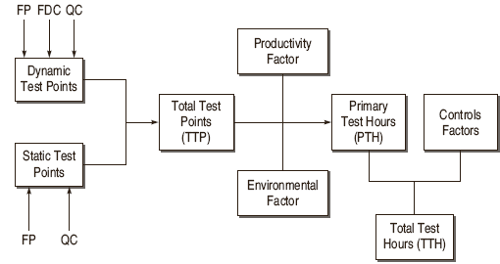
Test Point Analysis
© Oxford University Press 2011. All rights reserved.

Slide 17
Test Point Analysis
Calculating Dynamic Test Points
DTP = FP x FDCw x QCdw
Where DTP = number of dynamic test points
FP = Function point assigned to function
FDCw = Function dependent factor wherein weights are assigned to function dependent factors
QCdw = Quality characteristic factor wherein weights are assigned to dynamic quality characteristics
© Oxford University Press 2011. All rights reserved.

Slide 18
Test Point Analysis
FDCw = ((FIw + UINw + I + C) /20 ) x U
Where FIw = Function importance rated by user
UINw = Weights given to Usage intensity of the function, i.e. how frequently function is being used
I = Weights given to the function for interfacing with other functions, i.e. if there is change in function, how many functions in the system will be affected
C = Weights given to complexity of function, i.e. how many conditions are in the algorithm of function
U = Uniformity factor
© Oxford University Press 2011. All rights reserved.

Slide 19
QCdw=Quality Characterstics
Suitability
Security
Usability
effieciency
© Oxford University Press 2011. All rights reserved.

Slide 20
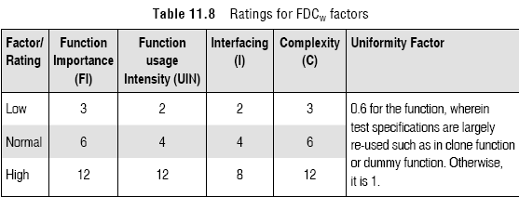
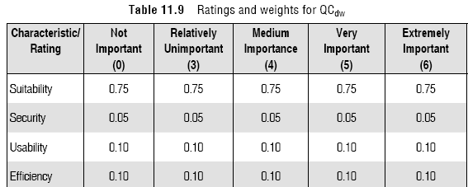
Test Point Analysis
QCdw = ∑ (rating of QC / 4) x weight factor of QC
© Oxford University Press 2011. All rights reserved.

Slide 21
Test Point Analysis
Calculating Static Test Points
STP = FP x ∑QCsw / 500
Where STP = Static Test Point
FP = Total function point assigned to system
QCsw = Quality characteristic factor wherein weights are assigned to static quality characteristics
Static quality characteristic is what can be tested with a checklist.
QCsw is assigned the value 16 for each quality characteristic which can be tested statically using the check list.
Total Test Points (TTP) = DTP + STP
© Oxford University Press 2011. All rights reserved.

Slide 22
Test Point Analysis
Calculating Primary Test Hours
Primary Test Hours (PTH) = TTP x Productivity factor x
Environmental factor
Productivity Factor ranges between 0.7 to 2.0.
Environmental factor = weights of (Test Tools +
Development Testing +
Test Basis +
Development Environment +
Testing Environment +
Testware ) / 21
© Oxford University Press 2011. All rights reserved.

Slide 23

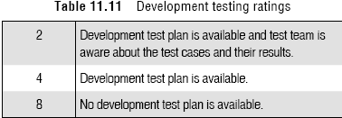
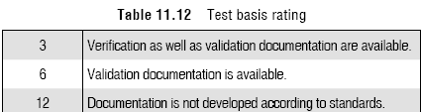
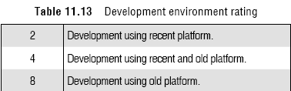
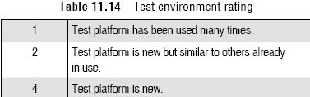
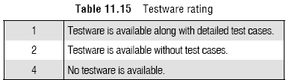
Test Point Analysis
© Oxford University Press 2011. All rights reserved.

Slide 24
Test Point Analysis
Calculating Total Test Hours
Total Test Hour = PTH + Planning and control allowance
Planning & Control Allowance (%)= weights of (Team size + Planning and Control Tools)
Planning & Control Allowance (hours)= Planning & Control Allowance (%) x PTH
© Oxford University Press 2011. All rights reserved.

Slide 25
Some Testing Metrics
Test Procedure Execution Status
= Number of Executed test cases / Total number of test cases
Defect Aging = Closing date of bug – Start date when bug was opened
Defect Fix Time to Retest = Date of fixing the bug and releasing in new
build – Date of Retesting the bug
Defect Density = Total number of defects found for a requirement /
Number of test cases executed for that requirement
© Oxford University Press 2011. All rights reserved.

Slide 26
Some Testing Metrics
Tester Productivity measures
Time spent in test planning
Time spent in test case design
Time spent in test execution
Time spent in test reporting
Number of test cases developed
Number of test cases executed.
Test Case Effectiveness metric
TCE = Number of defects found by the test cases / (Total number of defects) X 100
© Oxford University Press 2011. All rights reserved.

